Slide 1

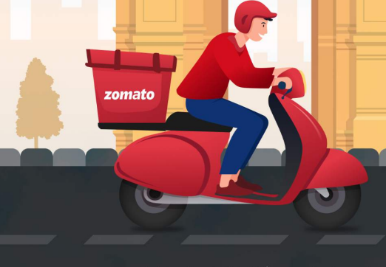
ZOMATO EXPANSION PROJECT
Presentation By -
Anita verma
From Newton School

Slide 2


Slide 3
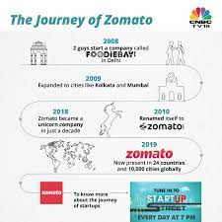
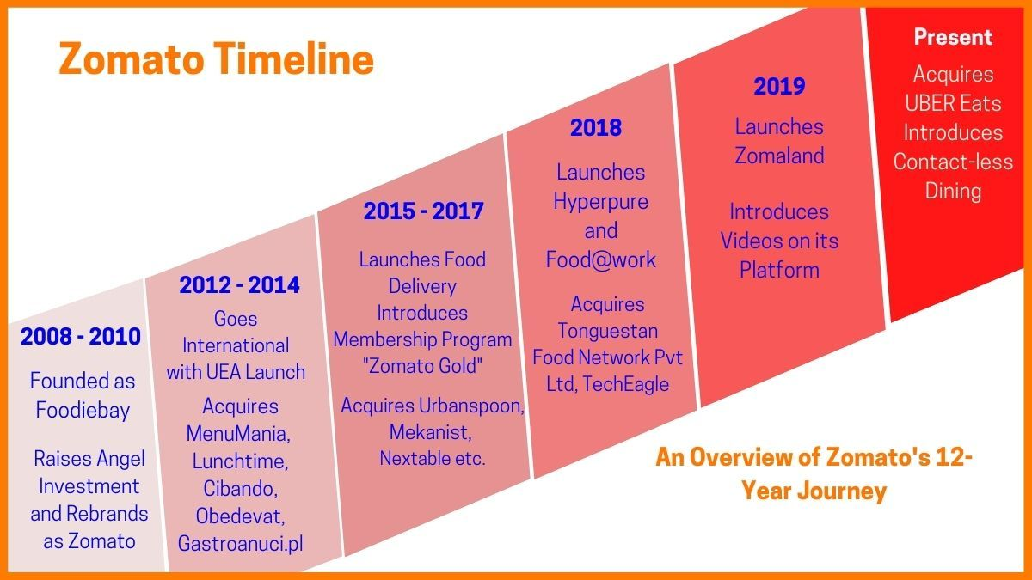
ZOMATO JOURNEY

Slide 4

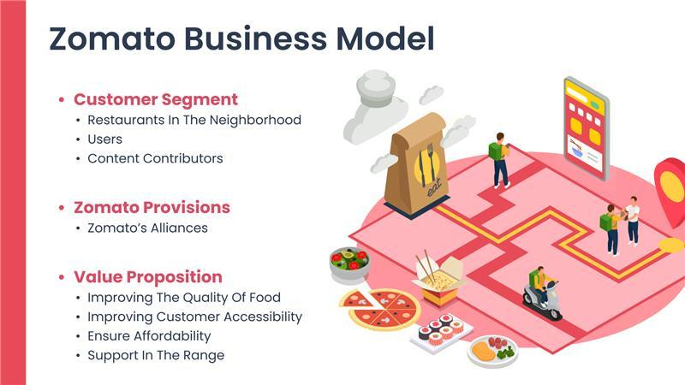

Slide 5
PROBLEM STATEMENT
SUGGESTING SOME COUNTRIES AND CITIES FOR OPENING NEW RESTAURANTS AND EXPANSION STRATEGIES FOR ZOMATO BY ANALYSING THEIR DATASETS.

Slide 6
Contents

Slide 7
Global Overview

Slide 8
Market Trends

Slide 9
Expansion Opportunities

Slide 10
number of restaurants of different price ranges in all the countries

Slide 11
Conclusion
Top 4 selected countries for our expansion are Australia, Canada, Singapore, Sri Lanka. Our Major Focus will be on Australia, As this Country has 3 most suitable cities.
According to our data, To get a higher rating, We must keep the rate of cuisines in the middle range, keep high quality cuisines and provide additional facilities in our new Restaurants.
We must offer more services like online delivery and table booking to increase the customer’s ratings because customers enjoy additional ease & convenience in their dining experience.

Slide 12
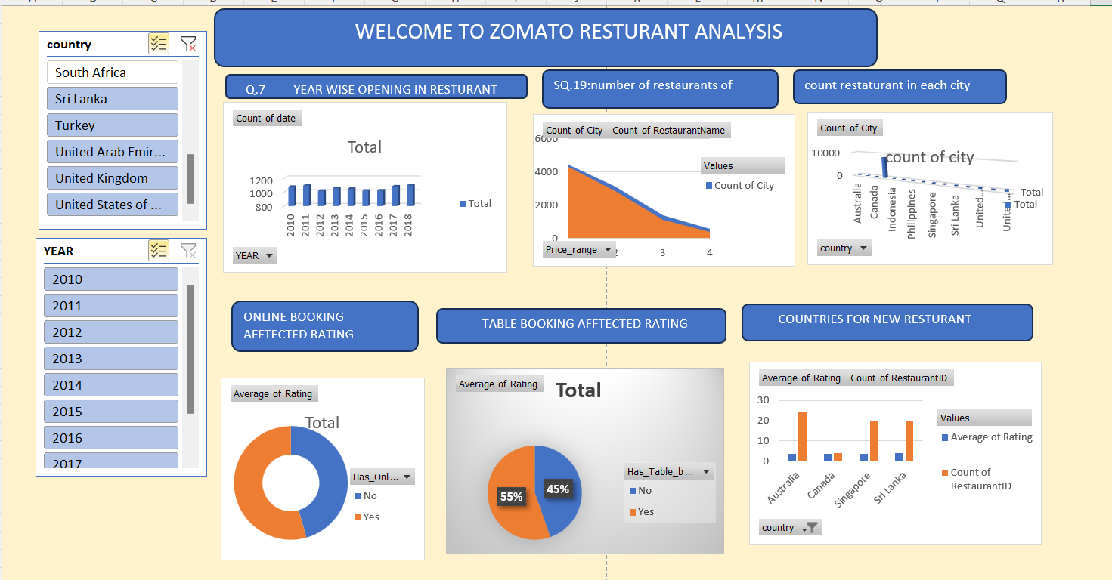
Dashboard

Slide 13
Do you have any questions?
Thank You

